Slide 1
Kwik-E-Kart
A better way to transition online

Slide 2
Who are we?
Axel and Paul. Kwik-E-Kart is a service used by professionals to transition their existing business online.

Slide 3
What do we offer?
As a service we focus on a few key areas:
Security
Ease of use
Friendly service

Slide 4


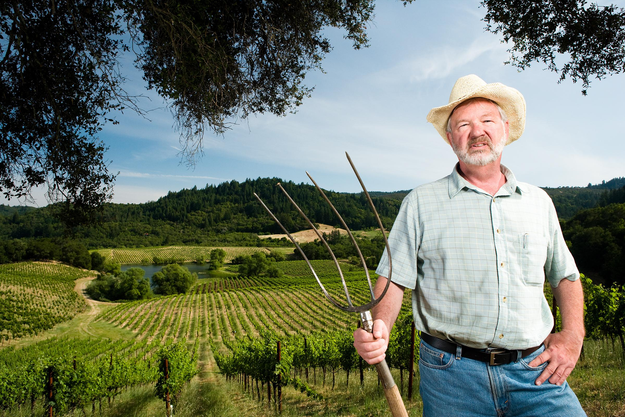

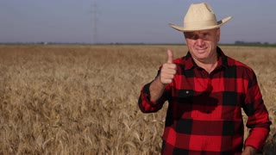
Roadmap

Slide 5
How do we do that?
Keeping it simple
Working in tandem with you and technology
Leveraging your creativity

